Slide 1
HOLDING ACCOUNT in PFMS EAT Module
PFMS State Directorate, West Bengal

Slide 2
General Information
A separate Bank Account to be called ‘Holding Account’ shall be opened for each Scheme by each Implementing Agencies handling Tax/Deductions.
The Bank Account is required to be opened preferebly in the same Bank as is the SNA/ZBA Bank Account.
It is a non-interest bearing Account & used only for transfer of Funds from PFMS (Not for any other source).
Money can be held in ‘Holding Account’ for 14 Days at Max.
Payment of deductions from ‘Holding Account’ would be made outside PFMS (Cheques, Challan, Internet Banking etc.)

Slide 3
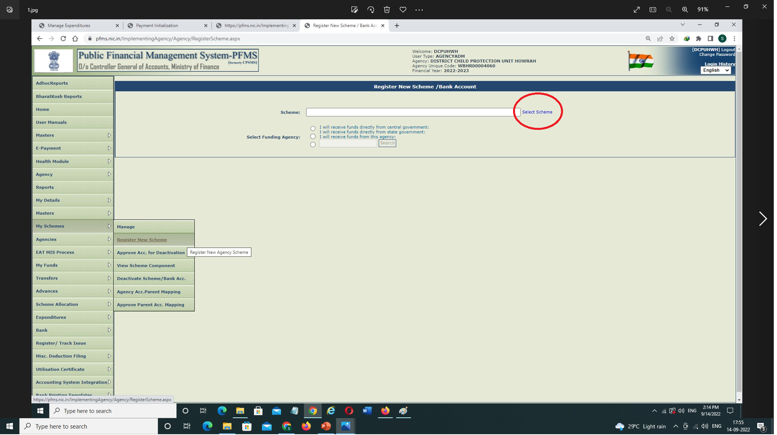
Registration of Holding Account
Login with Agency Admin → My Schemes → Register New Scheme→ click on select scheme →

Slide 4
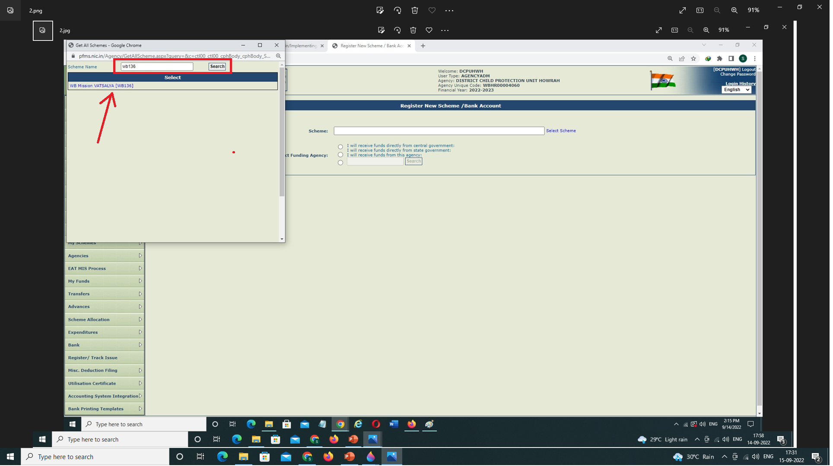
Registration of Holding Account – contd.
Enter your Scheme Code & click on search → then the Scheme name will appear on screen, select the Scheme →

Slide 5
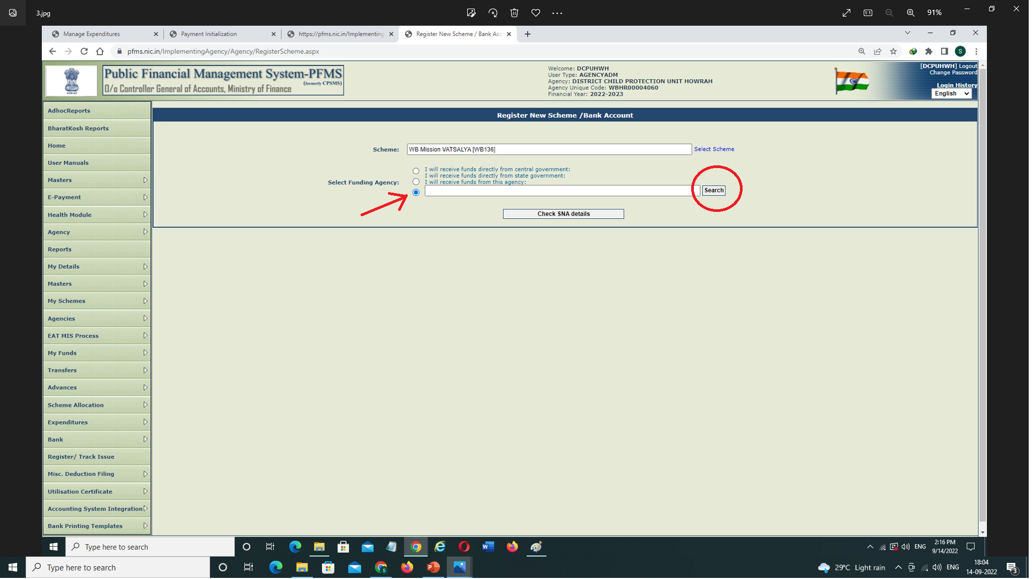
Registration of Holding Account – contd.
Select appropriate Funding Level Agency as "I will receive funds from this agency“ (Only for SNA, Funding Level will be the State Government) then click on search →

Slide 6
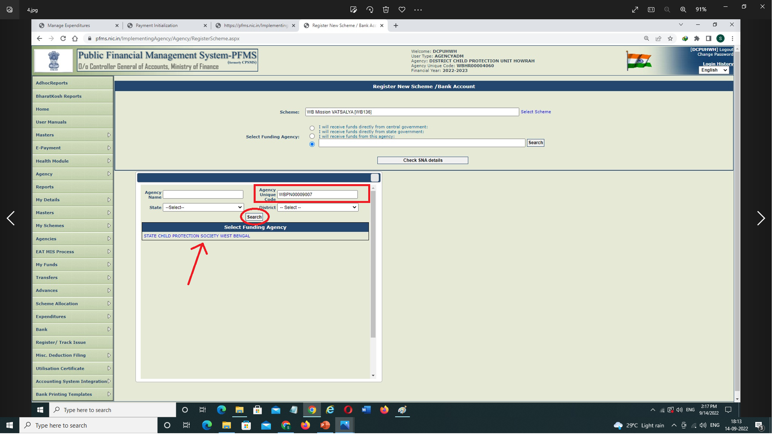
Registration of Holding Account – contd.
A Pop-up Table will appear, Enter Parent Level’s Unique Agency Code then click on search your Parent Level will appear, select the same →

Slide 7
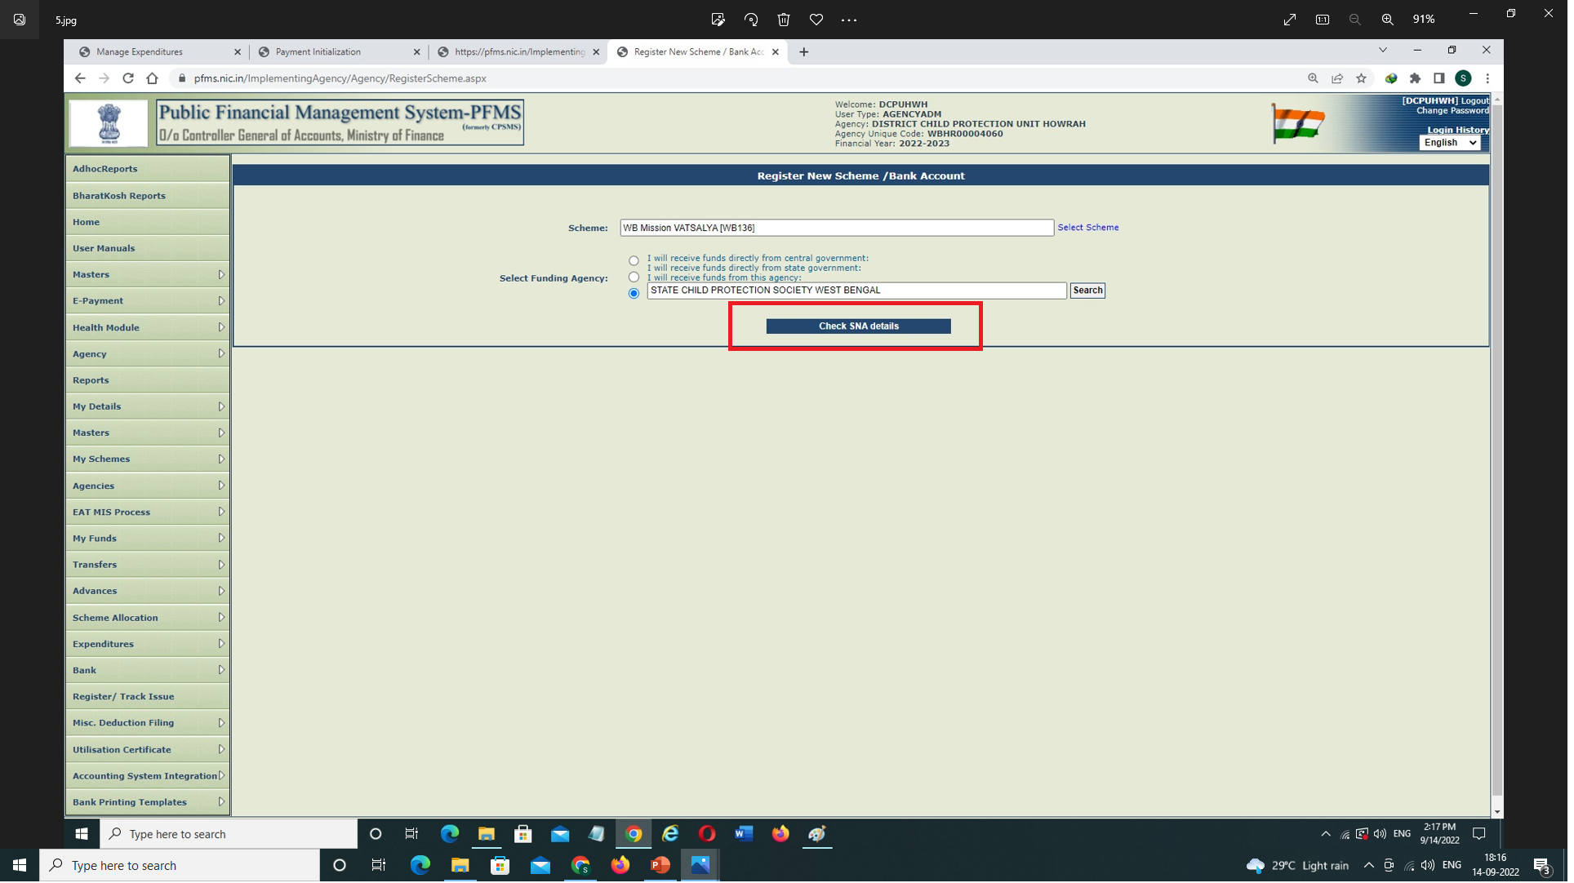
Registration of Holding Account – contd.
Click on Check SNA details →

Slide 8
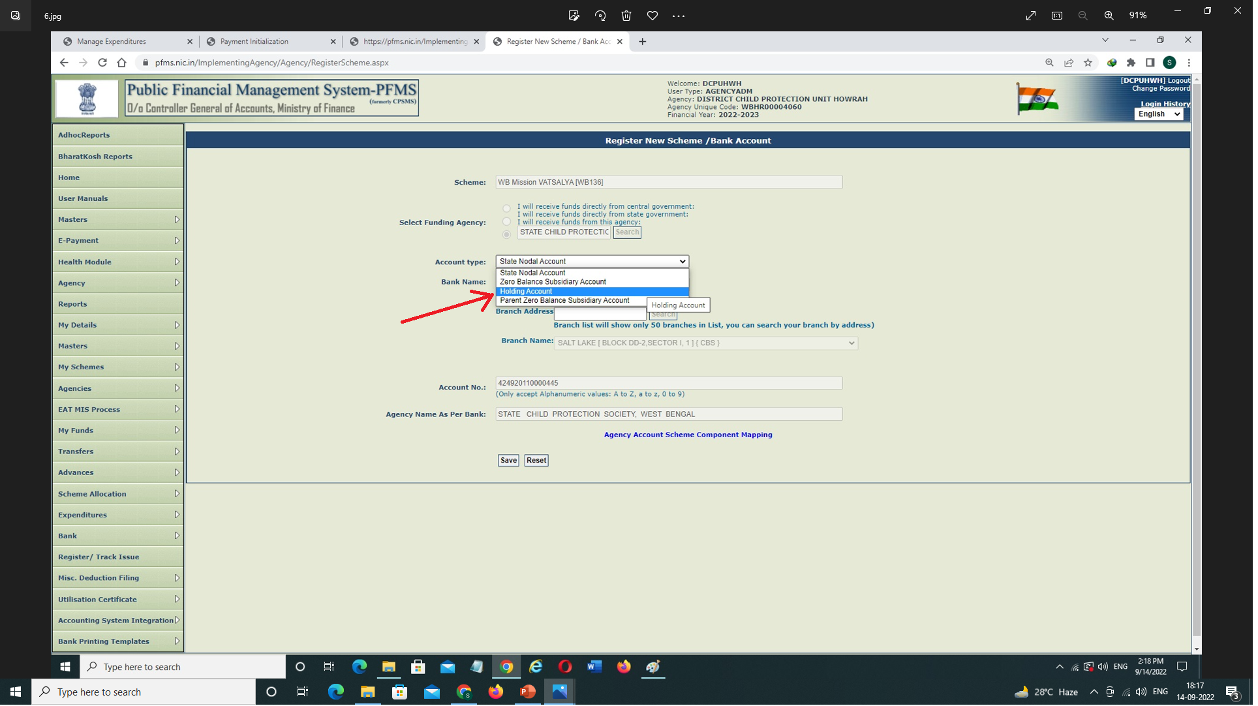
Registration of Holding Account – contd.
Select ‘Holding Account’ from the dropdown of ‘Account Type’ →

Slide 9
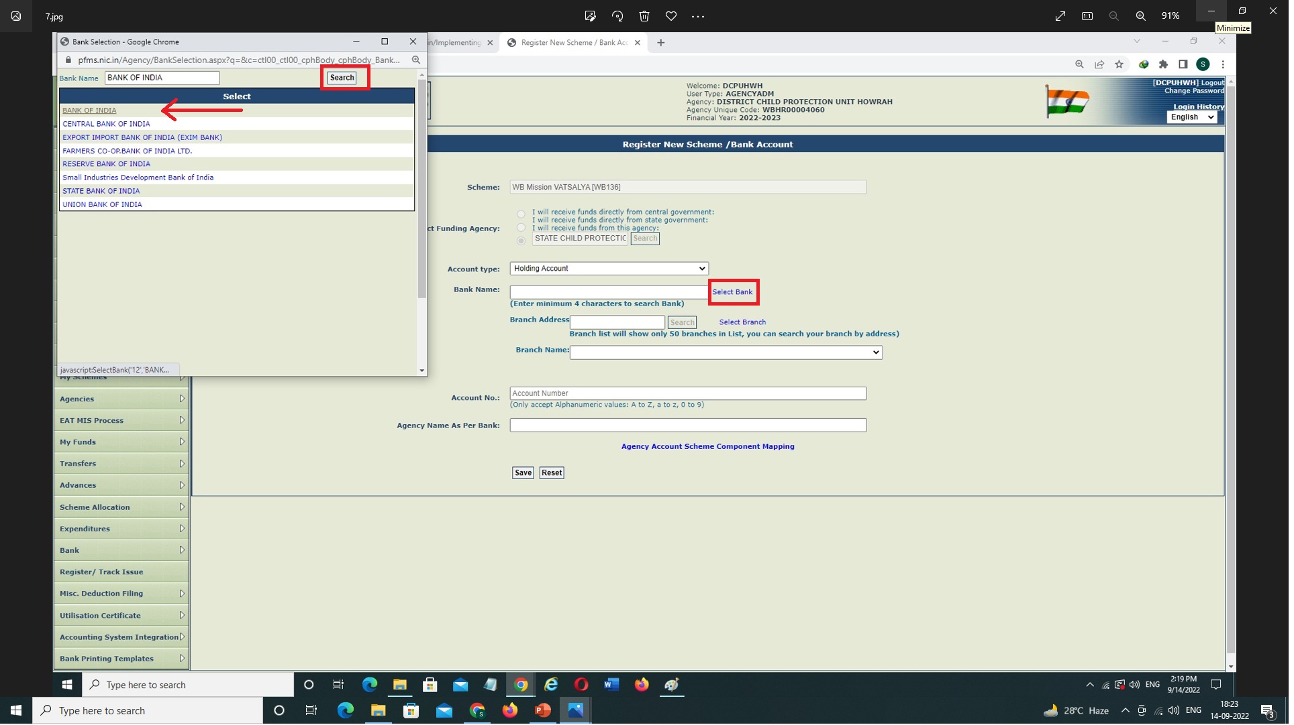
Registration of Holding Account – contd.
Click on Select Bank, a pop-up table will appear → Enter the Bank Name & Search → The Bank Name will be Displayed → Select the same →

Slide 10
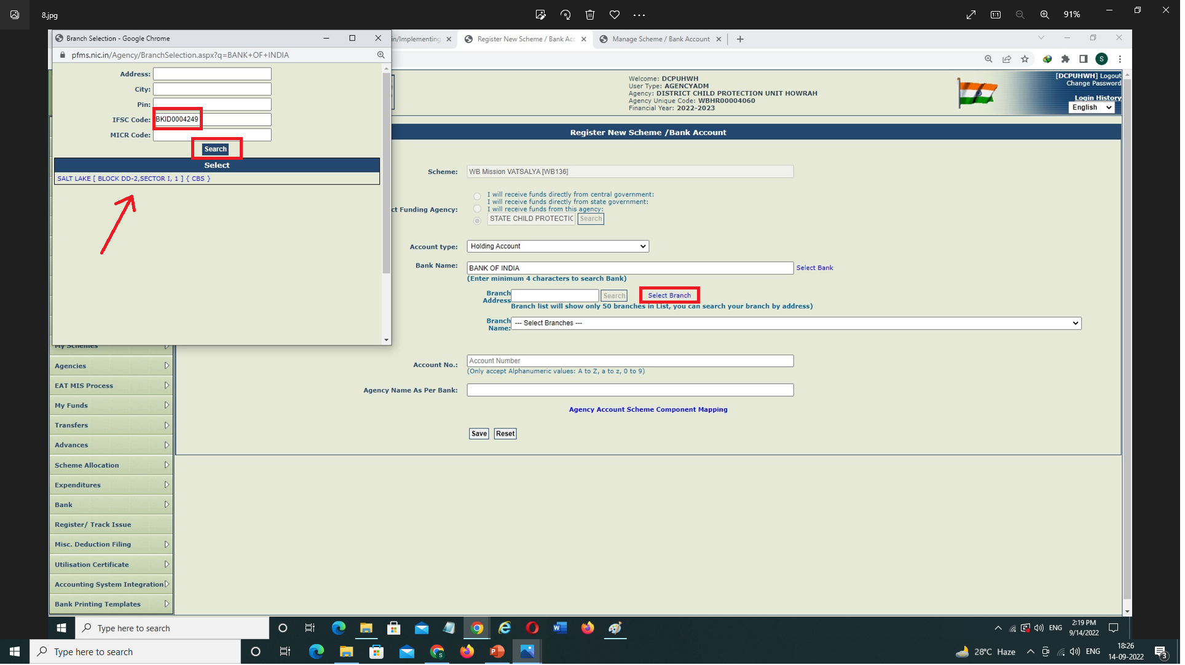
Registration of Holding Account – contd.
Click on ‘Select Branch’, a pop-up Table will appear. Enter the Bank IFSC Code & Search → Branch Address will be displayed → Select the same →

Slide 11
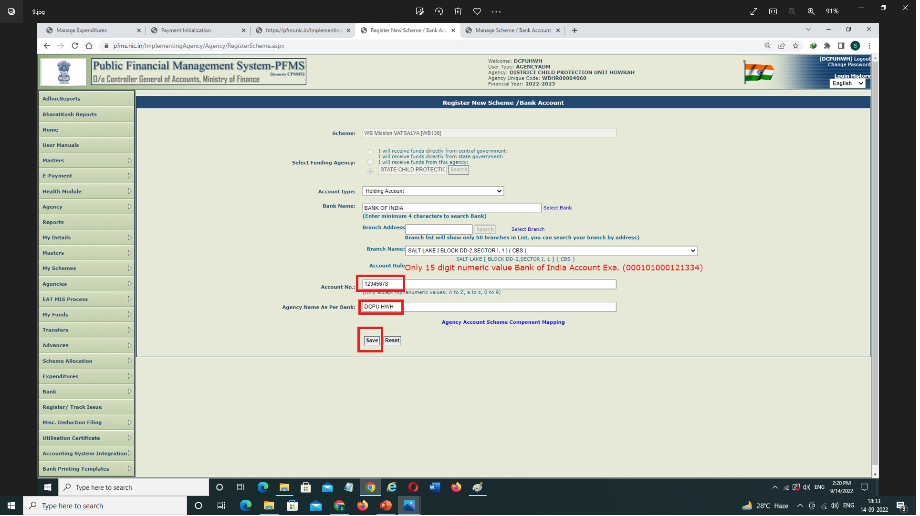
Registration of Holding Account – contd.
Enter the ‘Bank Account No.’ & ‘Agency Name as per Bank’ → Then ‘Save’

Slide 12
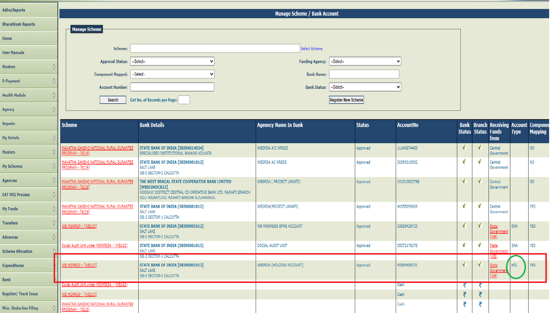
Registration of Holding Account – concld.
The Entry will be shown in My schemes → Manage (confirm that the ‘Account type’ column showing as ‘HOL’), then wait for Bank validation. Subsequent to Bank validation, approach the Parent Level Agency for approval.
After Bank validation Parent Level have to approve it by logging with their Admin ID → Agencies → Approve → then Approve that particular Entry.

Slide 13
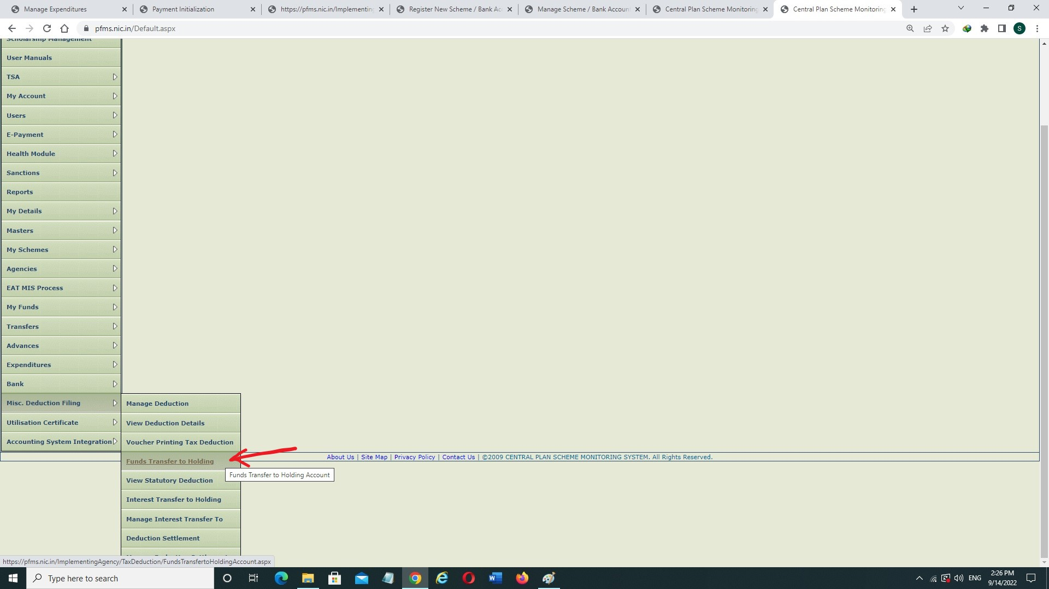
Funds Transfer to Holding Account
After performing an Gross Expenditure (Including Tax/Statutory Deductions) when the Net Payment credited successfully to Vendor’s Account, then IAs have to follow the below steps for transferring the Deduction Amount to Holding Account:
Login with DO ID → Click on Misc. Deduction filing → Click on Funds Transfer to Holding Account

Slide 14
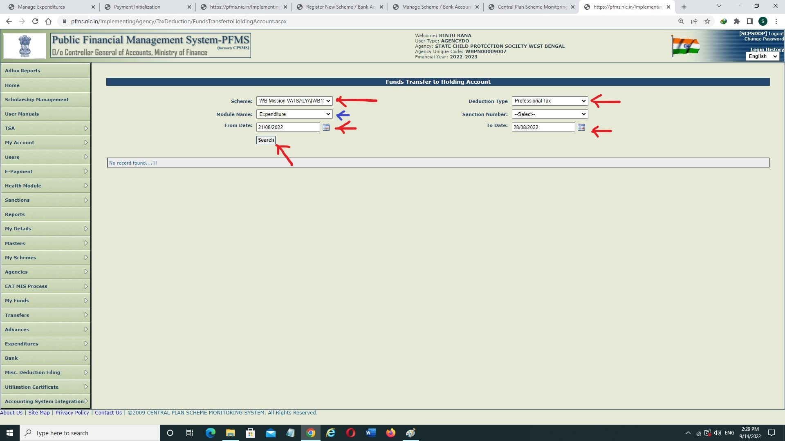
Funds Transfer to Holding Account – Contd.
Select Scheme from dropdown → Select Deduction Type from dropdown → Select Module Name from dropdown → Select From Date & To Date (Note: Sanction Date of the Voucher should be taken & Selection of Date should not be greater than 7 days) → Search

Slide 15
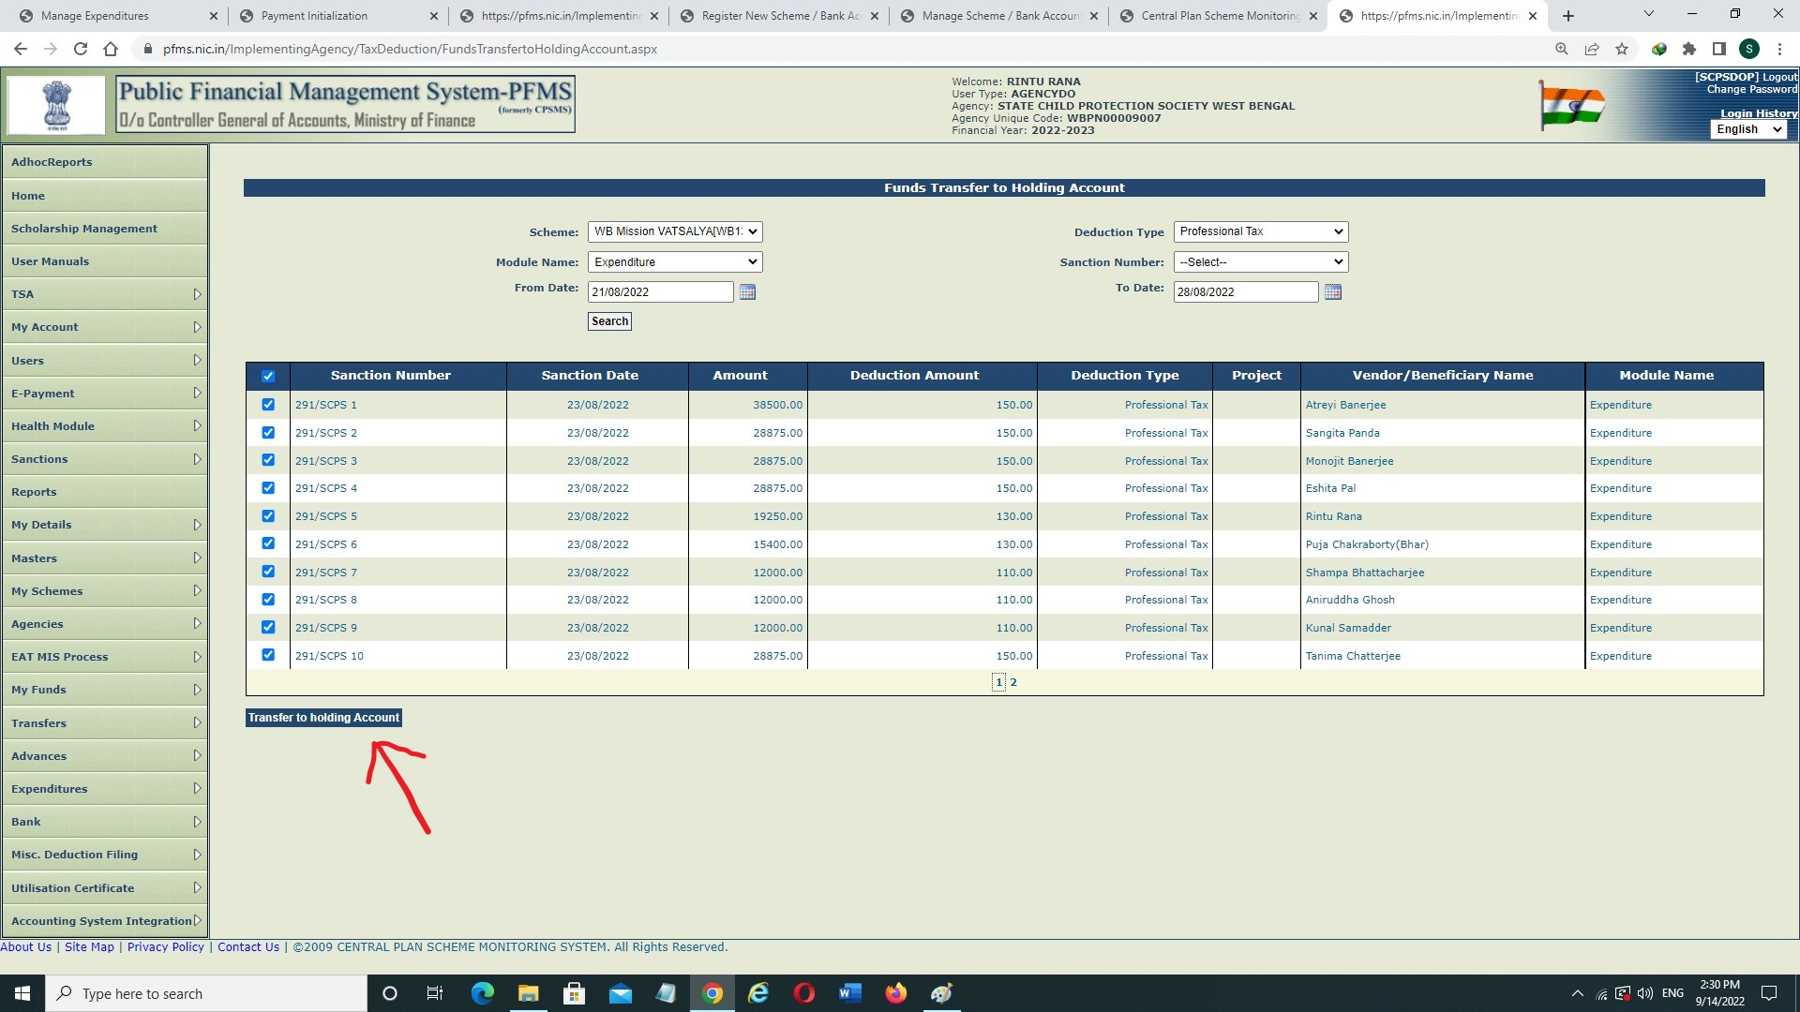
Funds Transfer to Holding Account – Contd.
Click on Check Box → click on Transfer to Holding Account →

Slide 16
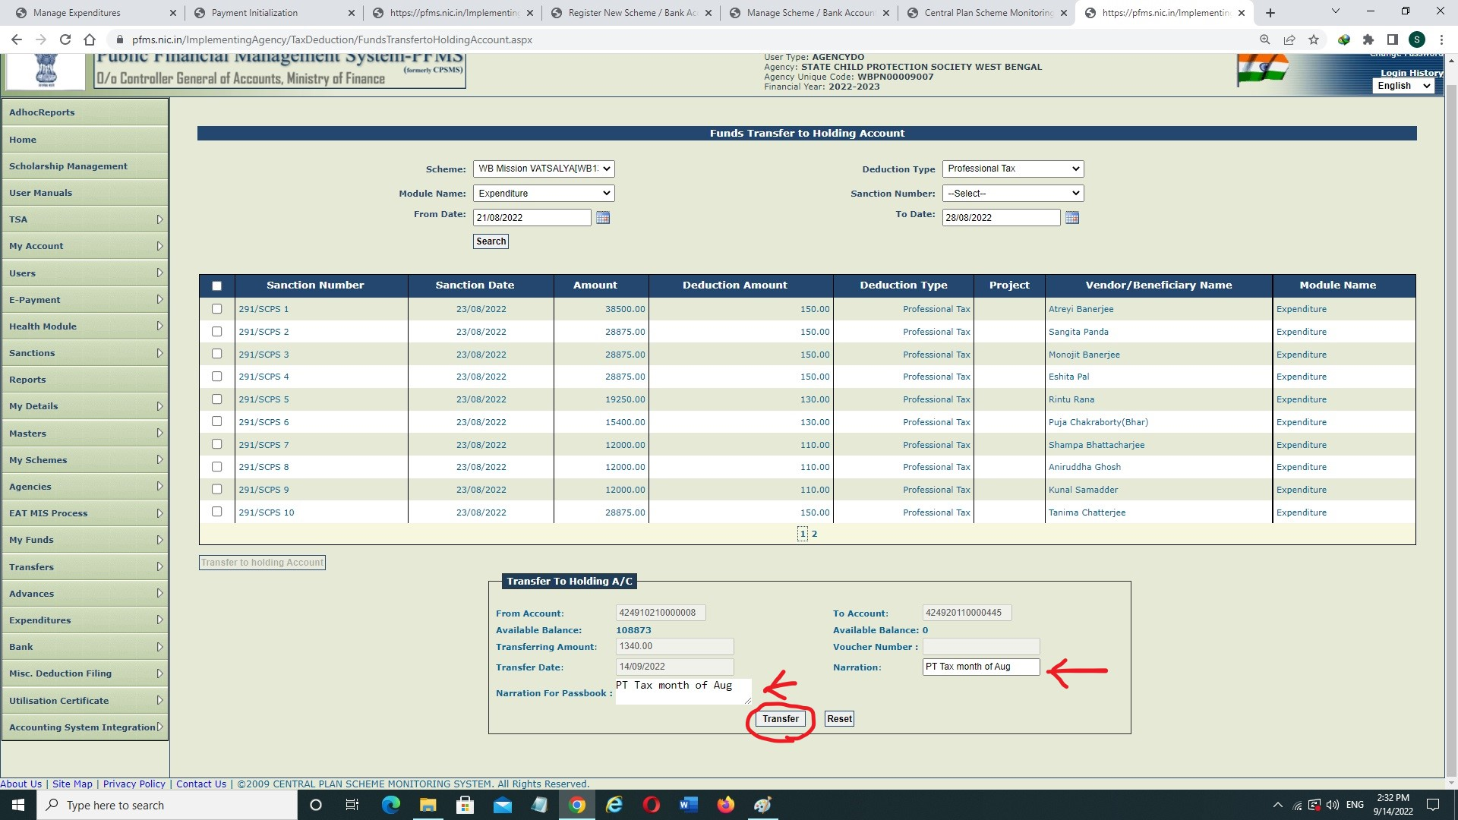
Funds Transfer to Holding Account – Contd.
Write Narration & Narration for Passbook → Click on Transfer →

Slide 17
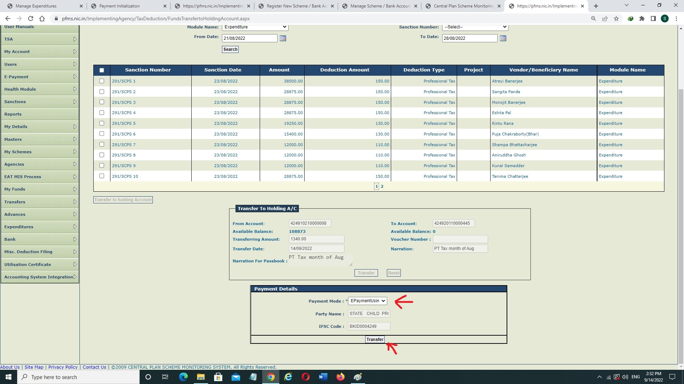
Funds Transfer to Holding Account – Contd.
Select Payment Mode → Click on Transfer →

Slide 18
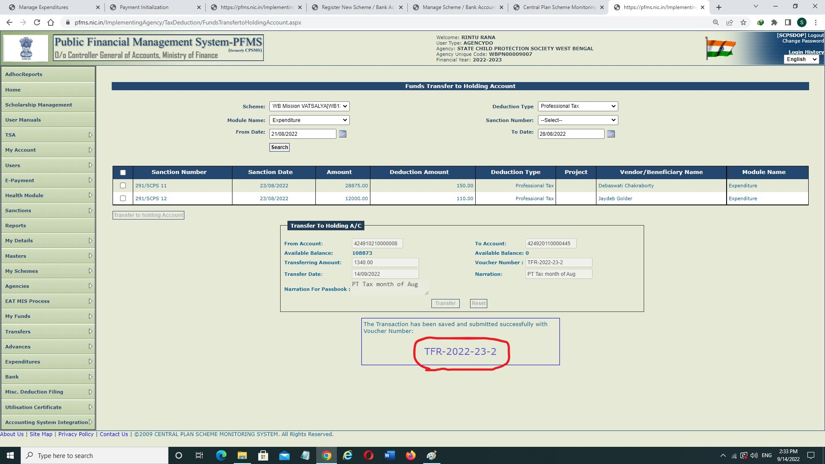
Funds Transfer to Holding Account – Contd.
A Voucher Number will be generated. You can write it down though the System will store the data.

Slide 19
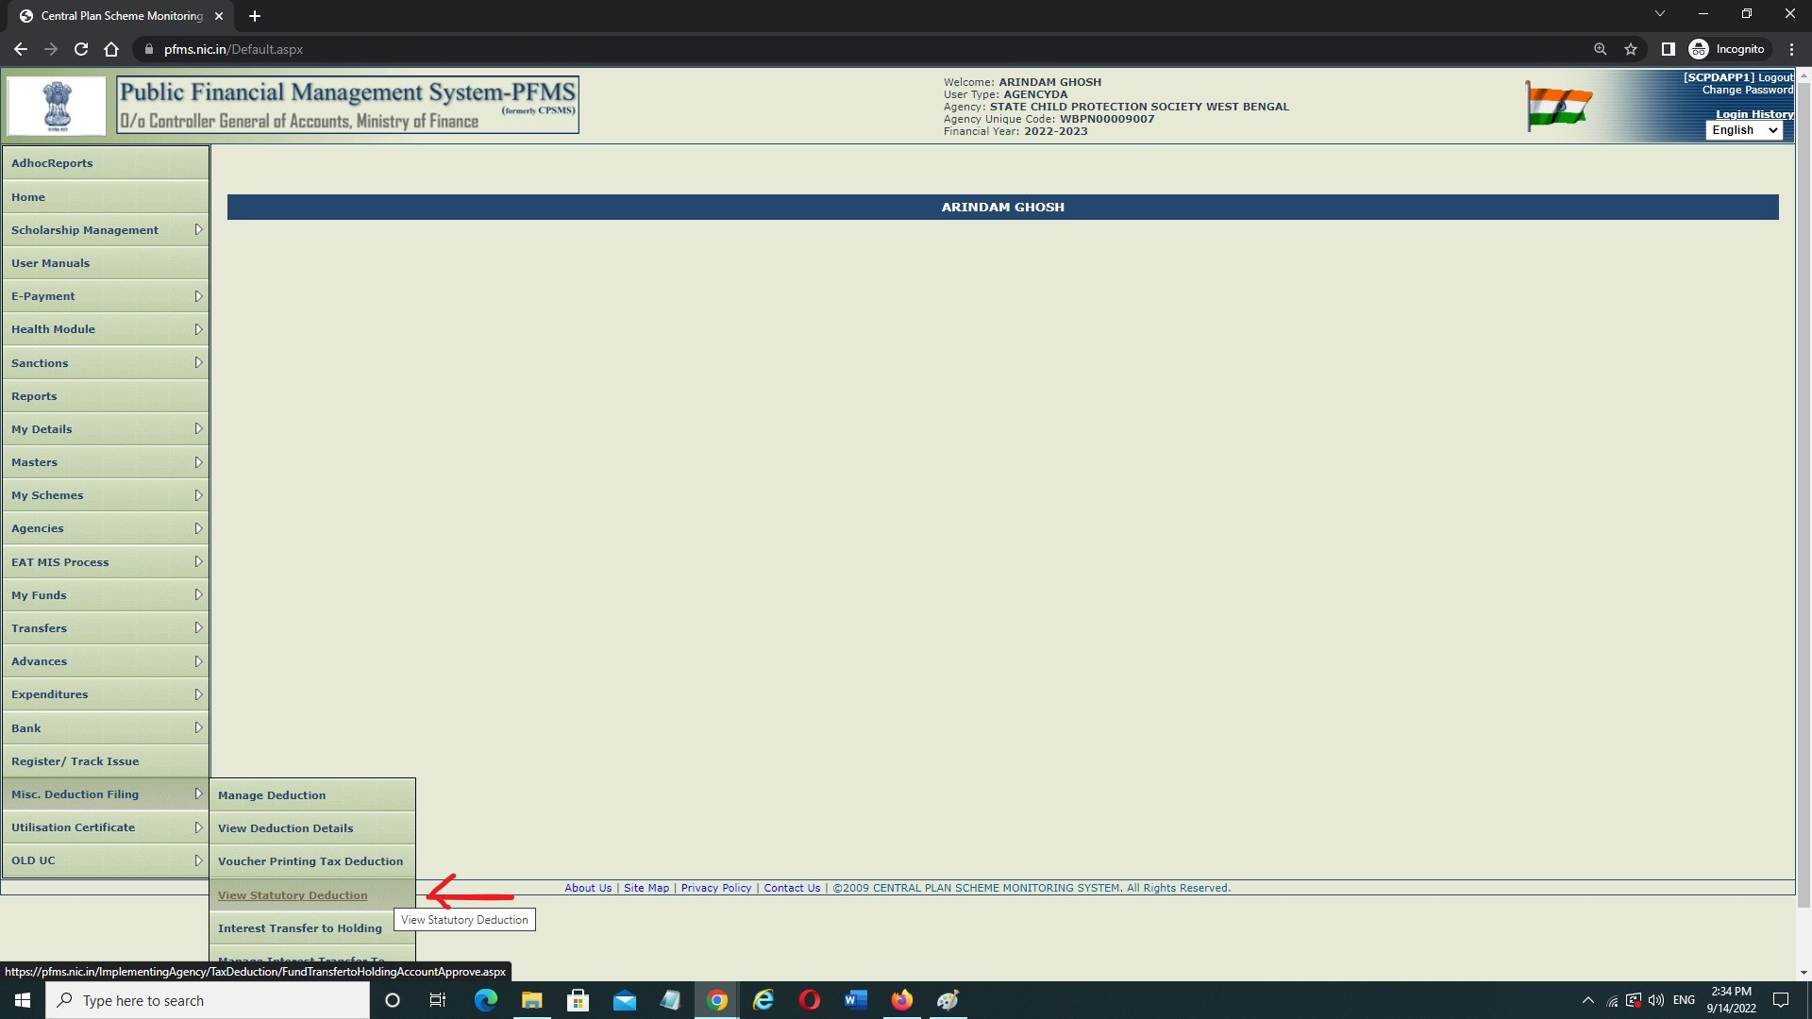
Funds Transfer to Holding Account – Contd.
Login with DA ID → Click on Misc. Deduction Filing → Click on View Statutory Deduction →

Slide 20
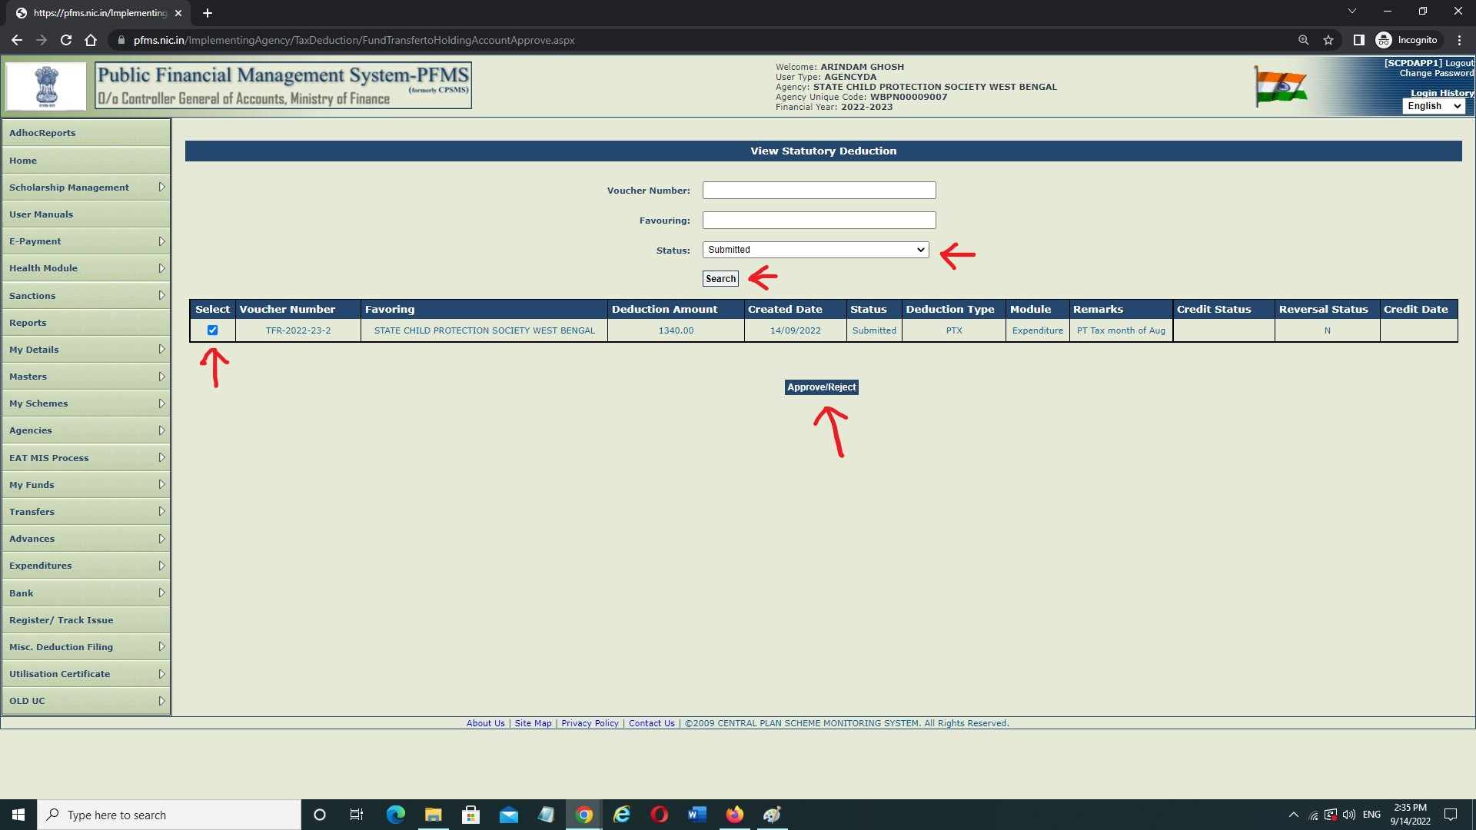
Funds Transfer to Holding Account – Contd.
Select Status as ‘Submitted’ from the Dropdown Menu → Click on Search → A table will appear with the deduction details → Click On Check Box → Click on Approve/Reject

Slide 21
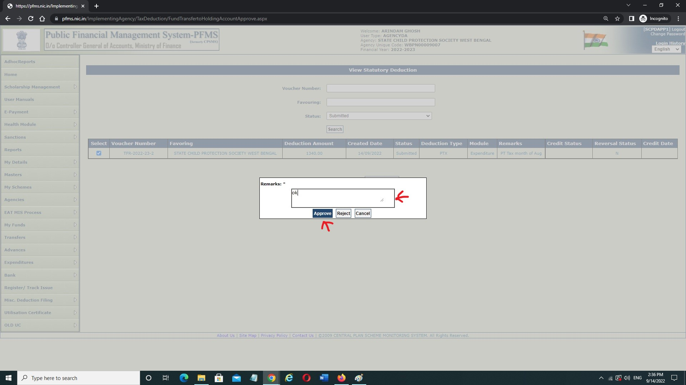
Funds Transfer to Holding Account – Concld.
Write down Remarks → Click on Approve or Reject as per requirement.
On Approval- In case of PPA Payment, Print Payment Advice will be generated & in case of DSC Payment, apply the DSC from E-Payment → Digitally Sign Payment File to Transfer the Fund.

Slide 22
Misc. Deduction Filing
After transferring the Funds to ‘Holding Account’, Payment of deductions from ‘Holding Account’ would be made outside PFMS (Cheques, Challan, Internet Banking etc.) within 14 Days from the date of transfer of Funds to ‘Holding Account’.
Subsequent to successful Payment of Deductions from Holding Account to the concerned authorities, Implementing Agencies have to file Deductions under Misc. Deduction filing.

Slide 23
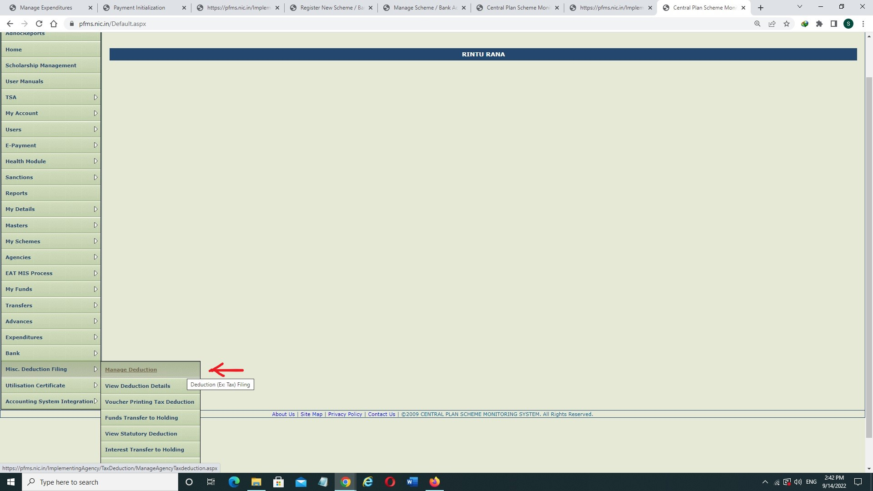
Misc. Deduction Filing – Contd.
Login with DO ID → Click on Misc. Deduction Filing → Click on Manage Deduction →

Slide 24
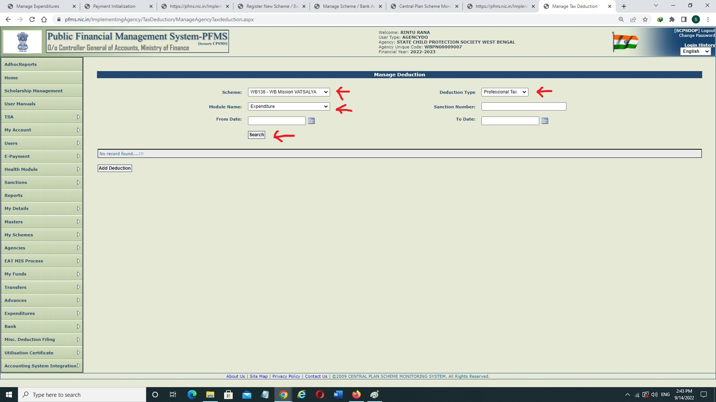
Misc. Deduction Filing – Contd.
Select Scheme → Select Deduction Type → Select Module → Click on Search →

Slide 25
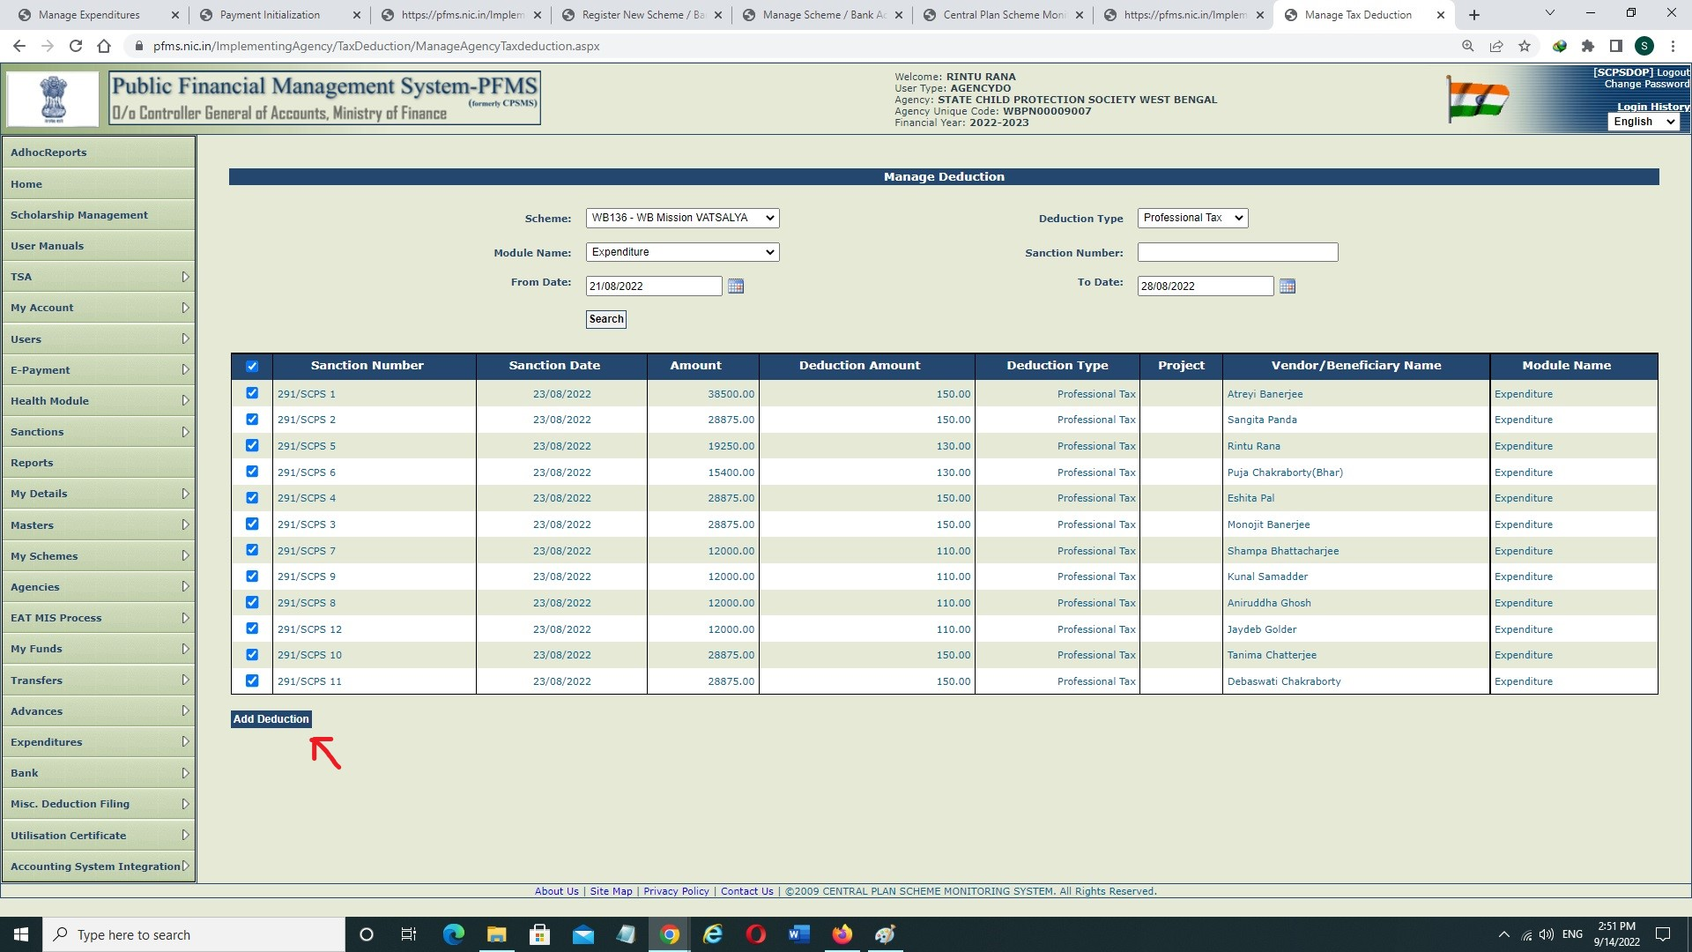
Misc. Deduction Filing – Contd.
Click on Check Box → Click on Add Deduction →

Slide 26
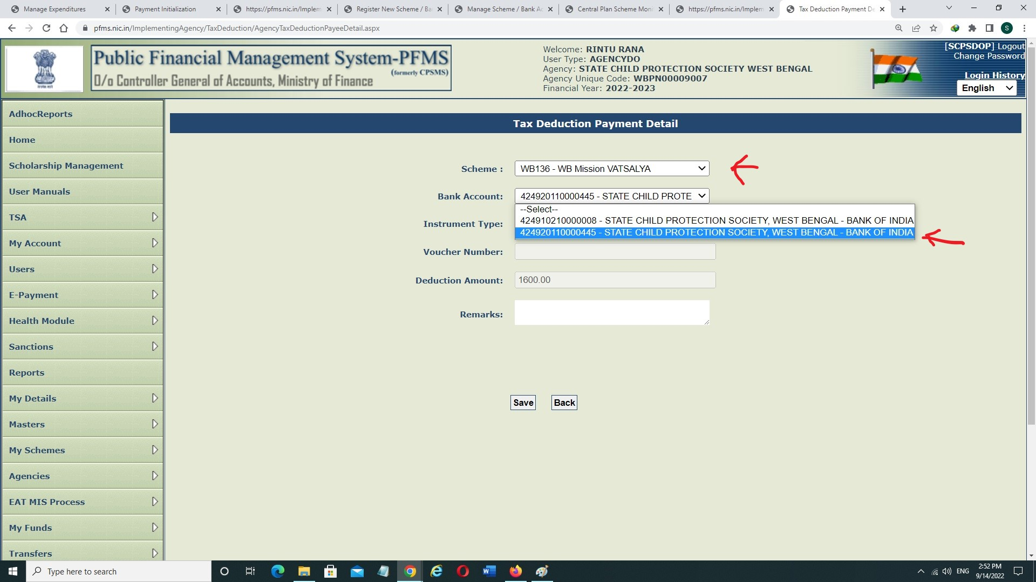
Misc. Deduction Filing – Contd.
Select Scheme → Select Bank Account (Holding Account) from dropdown →

Slide 27
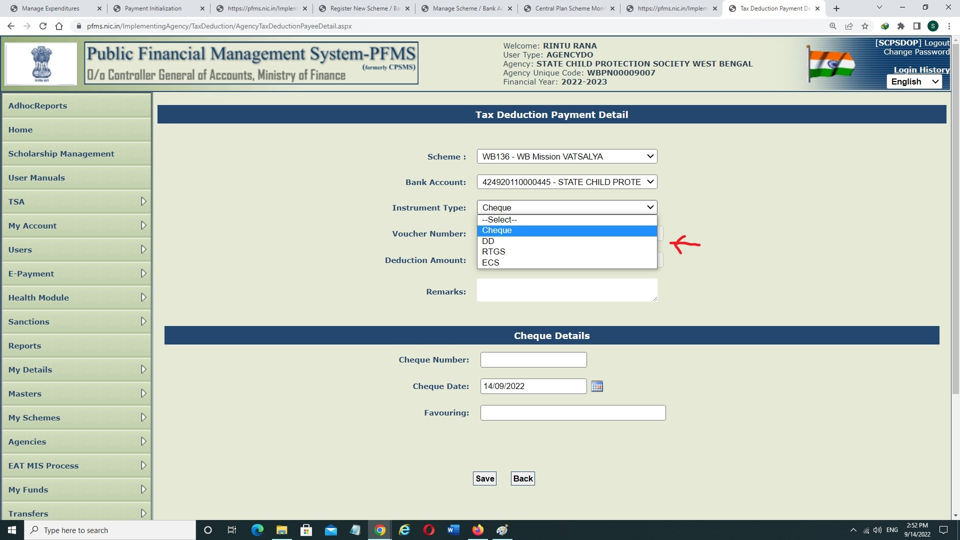
Misc. Deduction Filing – Contd.
Select Instrument Type from Dropdown →

Slide 28
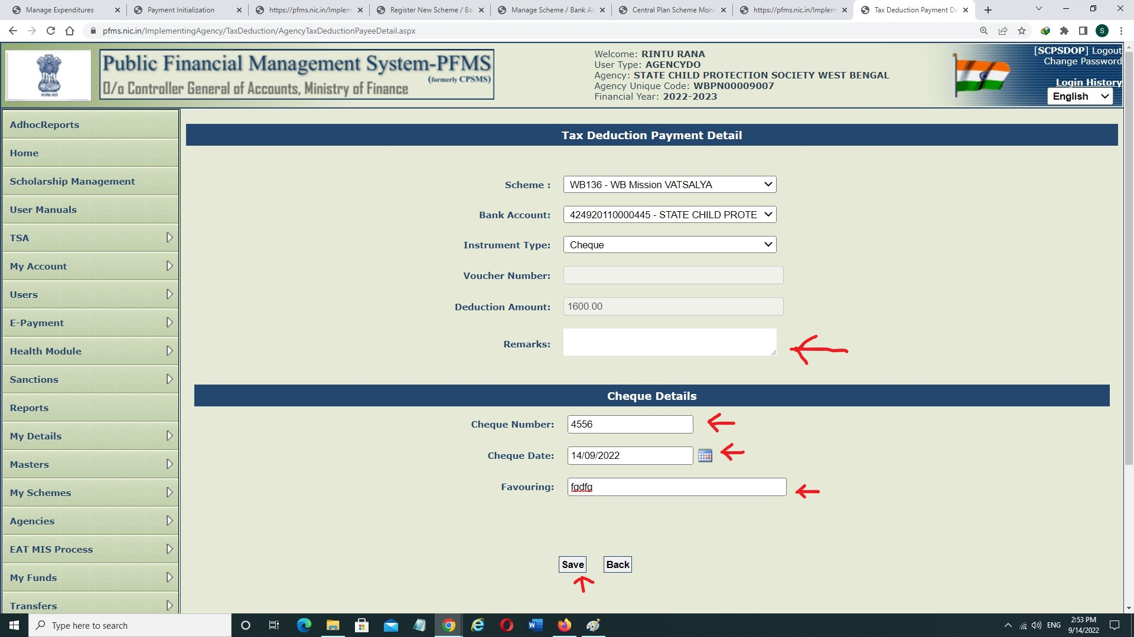
Misc. Deduction Filing – Contd.
Write down Remarks, Cheque Number, Cheque Date & Favouring → Click on Save

Slide 29
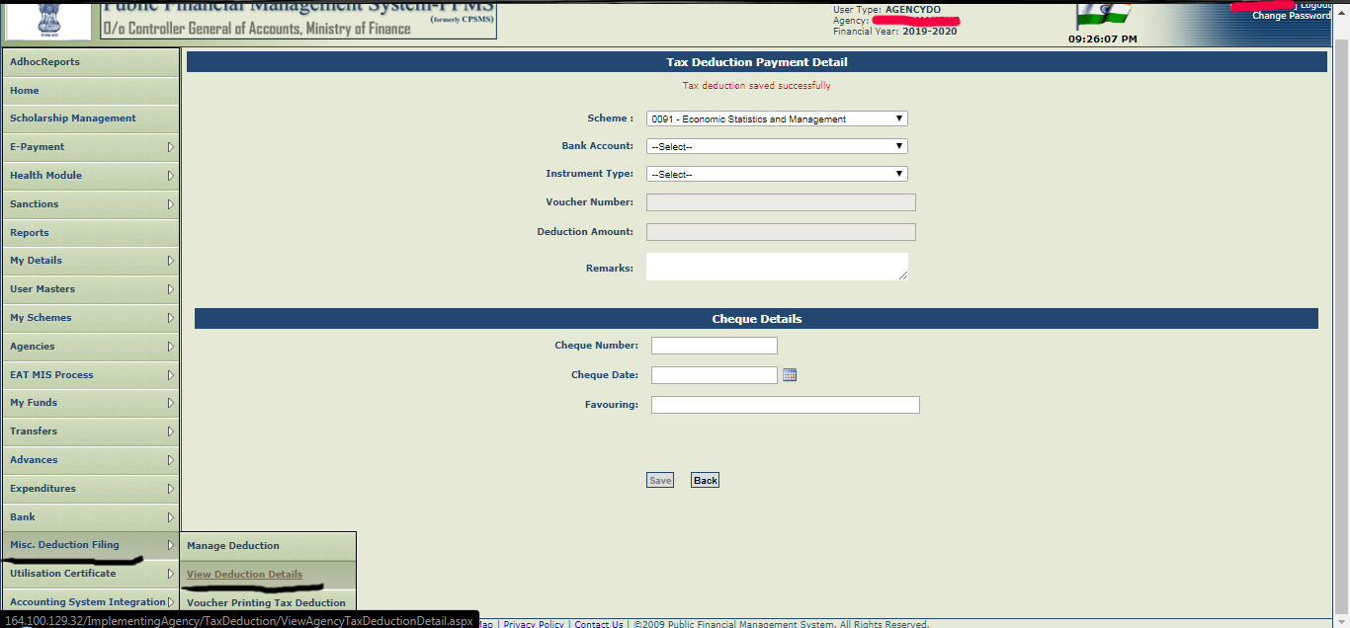
Misc. Deduction Filing – Contd.
Click on Misc. Deduction Filing → Click on View Deduction details

Slide 30
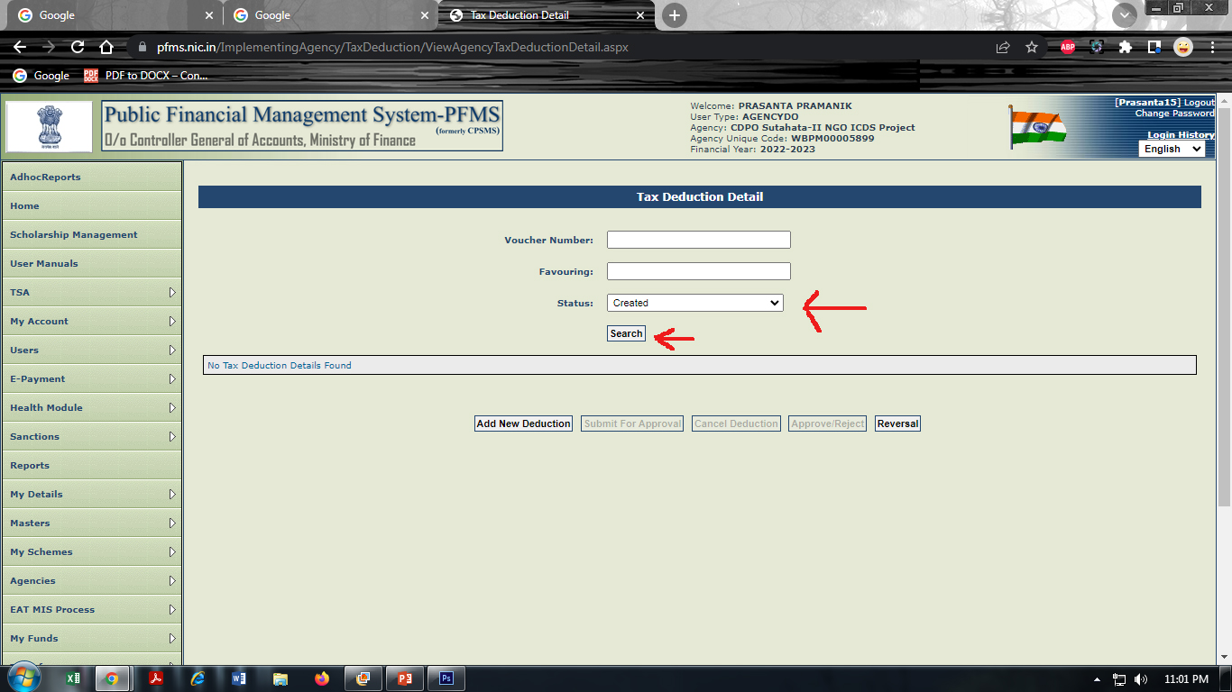
Misc. Deduction Filing – Contd.
Select Status as ‘Created’ From the dropdown → Click on Search

Slide 31
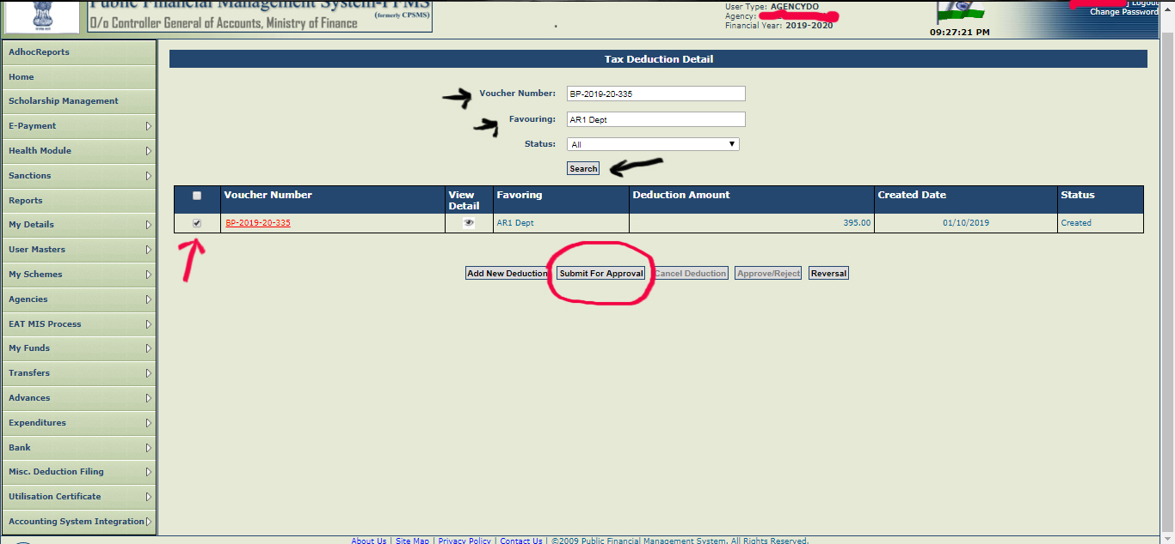
Misc. Deduction Filing – Contd.
Click on Check Box → Click on ‘Submit for approval’

Slide 32
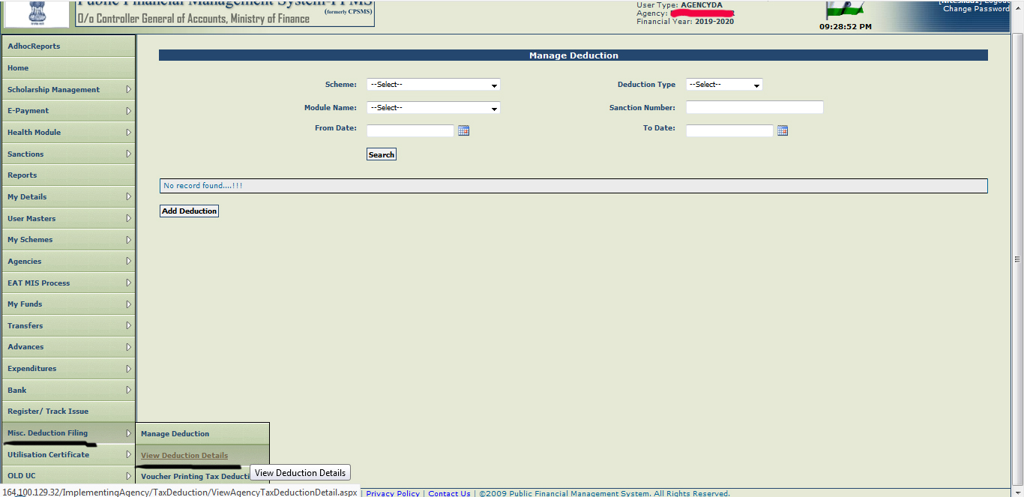
Misc. Deduction Filing – Contd.
Login with DA ID → Click on Misc. Deduction Filing → Click on View Deduction Details

Slide 33
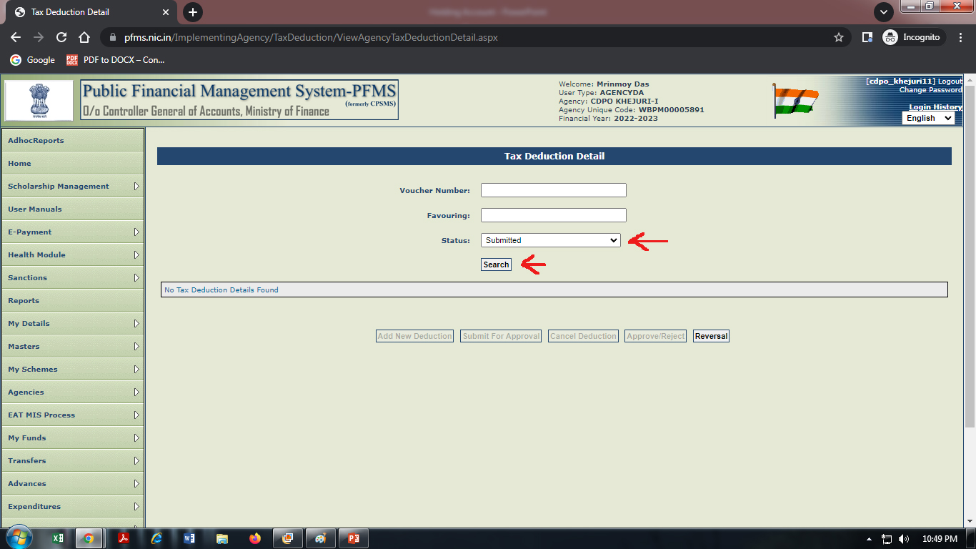
Misc. Deduction Filing – Contd.
Select Status as ‘Submitted’ From the dropdown → Click on Search

Slide 34
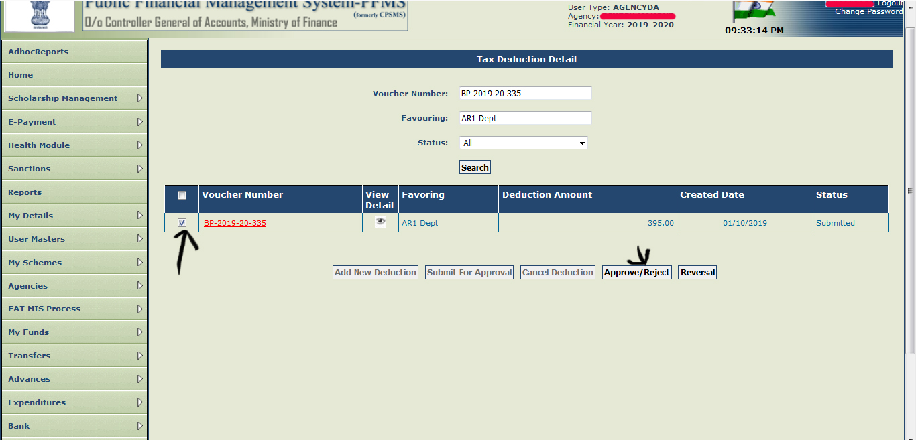
Misc. Deduction Filing – Contd.
Click on Check Box → Click on Approve/Reject

Slide 35
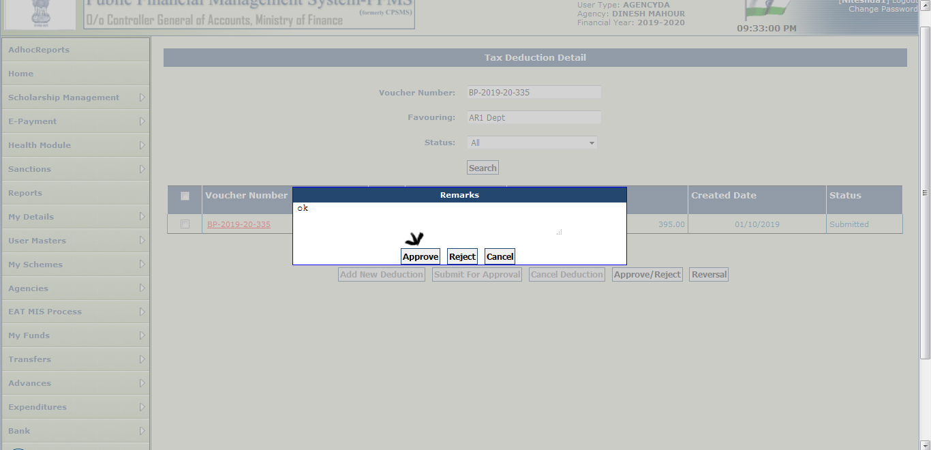
Misc. Deduction Filing – Concld.
Enter Remarks & ‘Approve’ the same

Slide 36
THANK YOU

